Slide 1
Variable Sampling Region RRT for
Emergency Evacuation Navigation in Urban Areas
指導教員 李羲頡 教授
Graduate School of Information, Production and Systems
System Control Laboratory
Yu Chuanyang 44191503

Slide 2
Contents
Introduction
1.1 Background
1.2 Previous Research
1.3 Issues and Ideas
Proposed VSR-RRT
2.1 Obstacle Detection
2.2 VSR-RRT
2.2.1 Idea of Variable Sampling Region
2.2.2 Idea of Greedy Path Optimization
Simulation
Conclusion
Notes:
Motivation, Issues, Ideas

Slide 3
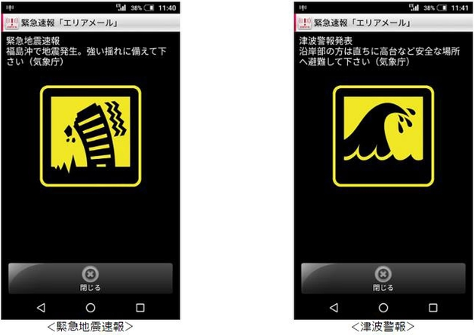




Background
Causes: nature disaster
Target: Fast and convenient path planning
for evacuation navigation in urban areas
Environment information
satellite and aerial image
緊急地震速報
津波警報
Map creation
image segmentation technique can be used to distinguish and mark out obstacles (buildings)
Research focus
Path planning method
in static known environment
Notes:
Target, based on

Slide 4

Previous Research (1/2)
A* algorithm (grid-based)
Start with a grid-based map
Search a path to the goal node by node
At each search step begin with the node with the lowest cost (distance, time, etc.)
RRT algorithm (sampling-based)
Nodes obtained by sampling in the space
Grow a tree by interconnecting nodes
A path can be found as a branch of the tree
Goal
Goal
Start
Start
node calculated
node can be used
in the path
path obtained
Fig.1 Example of A* algorithm
Fig.2 Example of RRT algorithm
Advantage:
Can find the theoretical shortest path
Disadvantage:
Long computation time in large maps
Advantage:
Short computation time even in large maps
Disadvantage:
Can't guarantee to find the shortest path
Notes:
Path planning methods can be broadly divided into…
the most commonly used grid-based
A* can find the theoretical /ˌθiːəˈretɪkl/ shortest path
sampling-based, RRT, can find a path, in a much shorter time

Slide 5
Previous Research (2/2)
RRT (Rapidly-exploring Random Tree)
Steven LaValle. 1996. Rapidly-exploring random trees: A new tool for path planning. Computer Science Department. Vol. 98 (11).
Grow a tree rooted at the start node by connecting new nodes one by one to the nearest node on the tree
The growth direction of the tree depends on a random node sampled in the map
Goal-biased RRT
Steven LaValle and James Kuffne. 2001. Randomized Kinodynamic Planning. International Journal of Robotics Research. Vol. 20 (5).
There is a small probability (goal bias) that sampling the goal
The higher this probability, the more greedily the tree grows towards the goal
Goal
Goal
random node
specified distance
(step size)
new node
nearest node
Start
Start
Fig.3 RRT algorithm
Fig.4 Goal-bias RRT algorithm
Notes:
Show how RRT works.
A new node will be located a specified distance away …

Slide 6
Previous Research (2/2)
RRT (Rapidly-exploring Random Tree)
Steven LaValle. 1996. Rapidly-exploring random trees: A new tool for path planning. Computer Science Department. Vol. 98 (11).
Grow a tree rooted at the start node by connecting new nodes one by one to the nearest node on the tree
The growth direction of the tree depends on a random node sampled in the map
Goal-biased RRT
Steven LaValle and James Kuffne. 2001. Randomized Kinodynamic Planning. International Journal of Robotics Research. Vol. 20 (5).
There is a small probability (goal bias) that sampling the goal
The higher this probability, the more greedily the tree grows towards the goal
Goal
Goal
random node
new node
Start
Start
Fig.3 RRT algorithm
Fig.4 Goal-bias RRT algorithm
Notes:
If a new node cannot…

Slide 7
Previous Research (2/2)
RRT (Rapidly-exploring Random Tree)
Steven LaValle. 1996. Rapidly-exploring random trees: A new tool for path planning. Computer Science Department. Vol. 98 (11).
Grow a tree rooted at the start node by connecting new nodes one by one to the nearest node on the tree
The growth direction of the tree depends on a random node sampled in the map
Goal-biased RRT
Steven LaValle and James Kuffne. 2001. Randomized Kinodynamic Planning. International Journal of Robotics Research. Vol. 20 (5).
There is a small probability (goal bias) that sampling the goal
The higher this probability, the more greedily the tree grows towards the goal
Goal
random node
Goal
new node
Start
Start
Fig.3 RRT algorithm
Fig.4 Goal-bias RRT algorithm
Notes:
The sampling procedure will be repeated until…
As we… growth can be biased by a probability of sampling in a specific area
G makes use of this to guide the search towards the goal

Slide 8

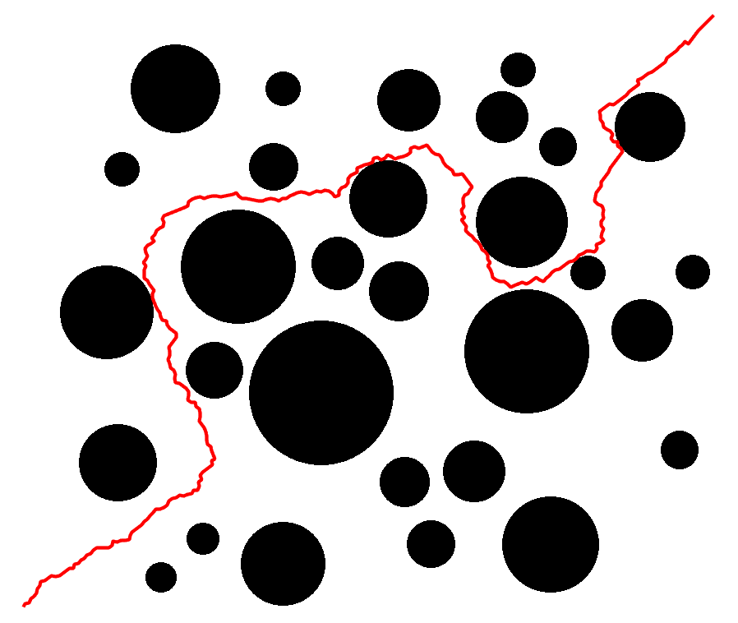
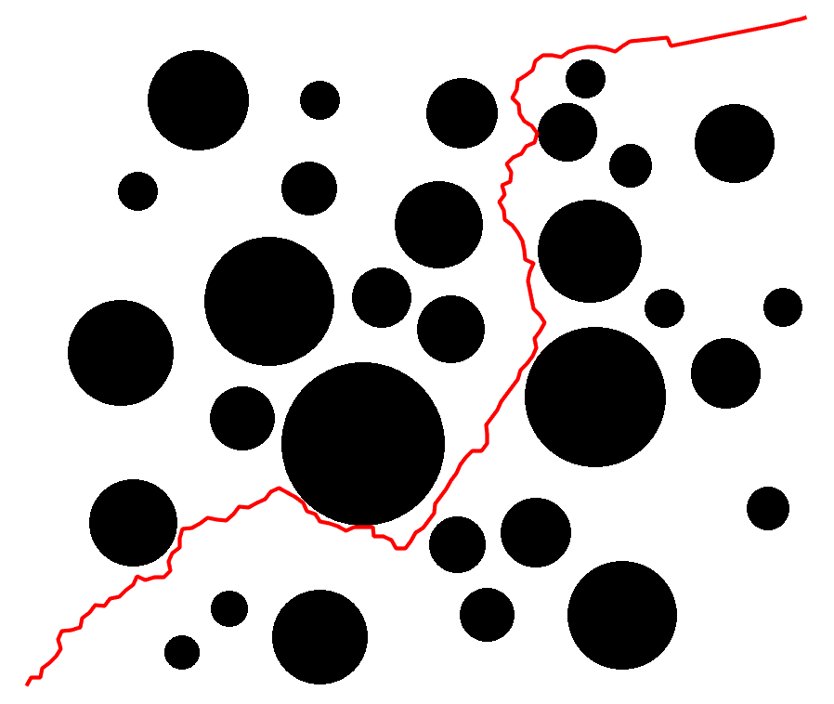
Issues and Ideas
Issues in RRT algorithm
It is hard to place nodes in narrow passages by sampling, that leads to long computation time.^{[1] [2]}
The path obtained is probably too much longer than a feasible shorter path, especially in a complex environment.^{[3]}
Goal
Goal
RRT is hard to
place nodes here
a path
planned by RRT
Start
Start
Start
Fig.5 Path (planed by RRT) extending to narrow area
Fig.6 Path planned by RRT and A*
[1]. Steven LaValle and James Kuffne. (2001). Randomized Kinodynamic Planning. The International Journal of Robotics Research. Vol. 20 (5), pp: 378-400.
[2]. S. Karaman & E. Frazzoli. (2011). Sampling-based algorithms for optimal motion planning. The International Journal of Robotics Research. Vol. 30, pp: 846-894.
[3]. H Zhang, Y Wang, J Zheng & J Yu. (2018). Path Planning of Industrial Robot Based on Improved RRT Algorithm in Complex Environments. IEEE Access. Vol. 6.

Slide 9

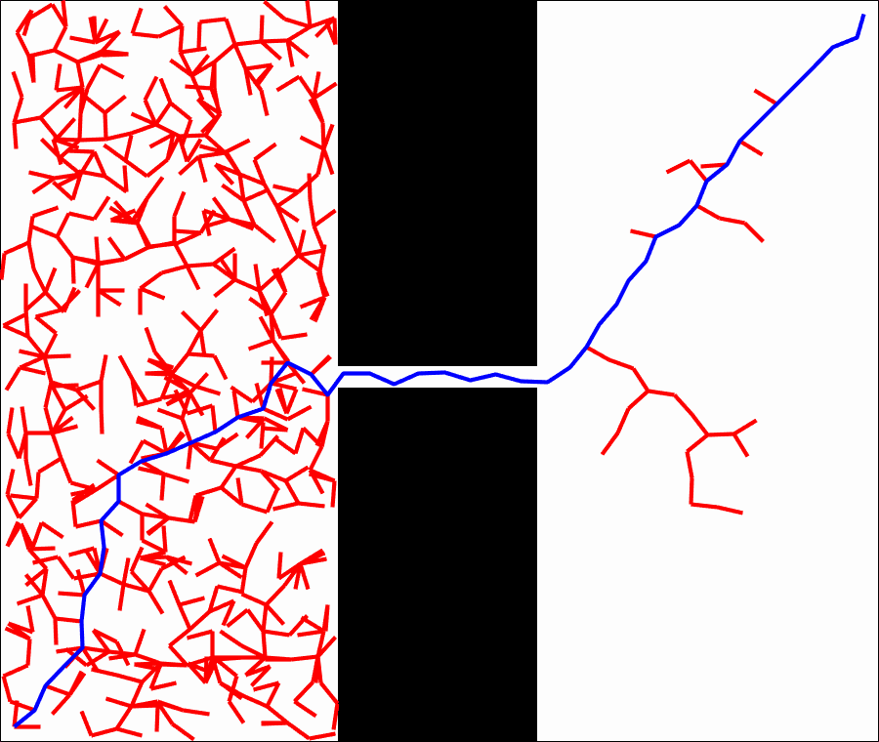
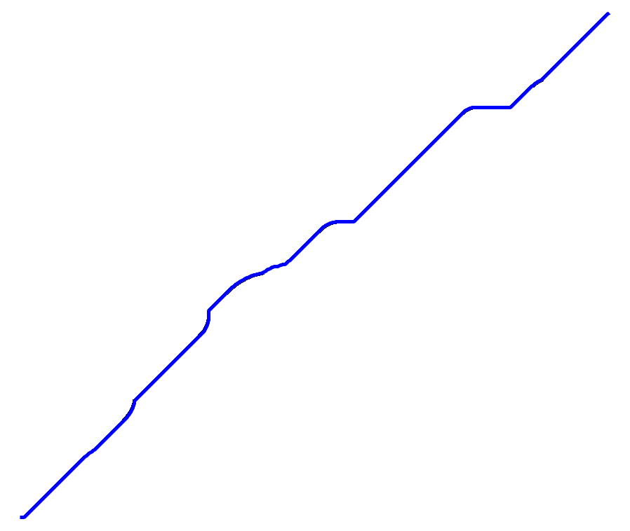
Issues and Ideas
Issues in RRT algorithm
It is hard to place nodes in narrow passages by sampling, that leads to long computation time.^{[1] [2]}
The path obtained is probably too much longer than a feasible shorter path, especially in a complex environment.^{[3]}
Goal
a shorter path planned by A*
Goal
RRT is hard to
place nodes here
a path
planned by RRT
Start
Start
Fig.5 Path (planed by RRT) extending to narrow area
Fig.6 Path planned by RRT and A*
[1]. Steven LaValle and James Kuffne. (2001). Randomized Kinodynamic Planning. The International Journal of Robotics Research. Vol. 20 (5), pp: 378-400.
[2]. S. Karaman & E. Frazzoli. (2011). Sampling-based algorithms for optimal motion planning. The International Journal of Robotics Research. Vol. 30, pp: 846-894.
[3]. H Zhang, Y Wang, J Zheng & J Yu. (2018). Path Planning of Industrial Robot Based on Improved RRT Algorithm in Complex Environments. IEEE Access. Vol. 6.

Slide 10

Issues and Ideas
Issues in RRT algorithm
It is hard to place nodes in narrow passages by sampling, that leads to long computation time.^{[1] [2]}
The path obtained is probably too much longer than a feasible shorter path, especially in a complex environment.^{[3]}
Idea: New method Variable Sampling Region RRT (VSR-RRT)
VSR-RRT reduces computation time by reducing invalid executions of the sampling procedure. This approach solves issue ①.
VSR-RRT is combined with a high goal bias to guide it grow directly towards the goal, which helps to generate shorter paths. This approach solves issue ②.
[1]. Steven LaValle and James Kuffne. (2001). Randomized Kinodynamic Planning. The International Journal of Robotics Research. Vol. 20 (5), pp: 378-400.
[2]. S. Karaman & E. Frazzoli. (2011). Sampling-based algorithms for optimal motion planning. The International Journal of Robotics Research. Vol. 30, pp: 846-894.
[3]. H Zhang, Y Wang, J Zheng & J Yu. (2018). Path Planning of Industrial Robot Based on Improved RRT Algorithm in Complex Environments. IEEE Access. Vol. 6.

Slide 11

Issues and Ideas
Issues in RRT algorithm
RRT often generates a zigzag path due to the randomness in picking up nodes.
zigzag part
Fig.7 Zigzag path problem in RRT
Idea: Greedy algorithm
Smooth the zigzag parts by reducing unnecessary nodes on the path.

Slide 12
Contents
Introduction
1.1 Background
1.2 Previous Research
1.3 Issues and Ideas
Proposed VSR-RRT
2.1 Obstacle Detection
2.2 VSR-RRT
2.2.1 Idea of Variable Sampling Region
2.2.2 Idea of Greedy Path Optimization
Simulation
Conclusion
Notes:
In the next part I will elaborate[ɪˈlæb(ə)rət] on my research content in detail.

Slide 13
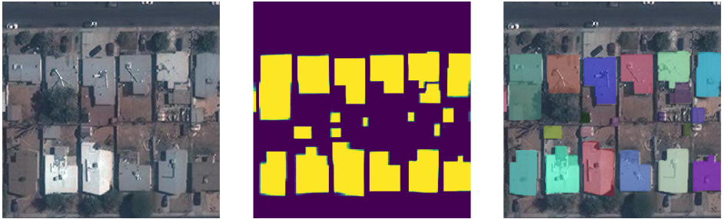
Obstacle Detection
UNET (Image segmentation)
A Small dataset is OK for training
Each pixel is classified to obtain high segmentation accuracy
Fast to segment image with trained model
UNET Implementation:
Map Dataset: Aerial imageries of urban areas provided by University of Toronto
https://www.cs.toronto.edu/~vmnih/data/
Dataset features:1500 × 1500 pixels for an area of 2.25 square kilometers
covers roughly 340 square kilometers urban areas in Massachusetts, U.S.
Input: Urban aerial imagery
Image
UNET output
Prediction
Output: picture of predicted object
building->obstacle others->free space
output is used as map for path planning
Fig.8 A sample of UNET detection result

Slide 14

Idea of Variable Sampling Region
Original RRT
Sample probably anywhere in the whole map
VSR-RRT
Sample in a small area centered on the new node after every invalid sampling
Probability up, thus calculation time down
Combined with a high goal bias, to reduce the length of the path
Probability of sampling is valid:
$$\frac{S_{\text{valid} \text{sampling} \text{region} ∩ \text{sampling} \text{region}}}{S_{\text{sampling} \text{region}}}$$
sampling region (entire map)
Fig.9 Traditional RRT sampling process
Fig.10 VSR-RRT sampling process
Notes:
To illustrate /ˈɪləstreɪt/ this approach more clearly, this page shows VSR versus Ori.
Ori RRT sample the random node ...

Slide 15
Idea of Variable Sampling Region
Original RRT
Sample probably anywhere in the whole map
VSR-RRT
Sample in a small area centered on the new node after every invalid sampling
Probability up, thus calculation time down
Combined with a high goal bias, to reduce the length of the path
Probability of sampling is valid:
$$\frac{S_{\text{valid} \text{sampling} \text{region} ∩ \text{sampling} \text{region}}}{S_{\text{sampling} \text{region}}}$$
sampling region (entire map)
valid
sampling region
only new node located on this red arc can guide RRT to enter this narrow passage
new node will be located on this circle
step size
Fig.9 Traditional RRT sampling process
Fig.10 VSR-RRT sampling process
Notes:
RRT grows by a certain distance at a time, now assume that it grows begin with such a state…
A new node that is closest to this node will
To make sure , must be picked up within…
Thus, Probability can be expressed by the ratio of the area of the overlapping part of… to
Triangle / Rectangle.

Slide 16
Idea of Variable Sampling Region
Original RRT
Sample probably anywhere in the whole map
VSR-RRT
Sample in a small area centered on the new node after every invalid sampling
Probability up, thus calculation time down
Combined with a high goal bias, to reduce the length of the path
Probability of sampling is valid:
$$\frac{S_{\text{valid} \text{sampling} \text{region} ∩ \text{sampling} \text{region}}}{S_{\text{sampling} \text{region}}}$$
sampling region (entire map)
valid
sampling region
Small probability leads to many invalid samplings
valid
sampling region
new node
The location of narrow passages relative to the whole map will further reduce the probability
sampling region
Fig.9 Traditional RRT sampling process
Fig.10 VSR-RRT sampling process
Notes:
ratio Triangle / Rectangle.
In the same case, Probability is increased significantly

Slide 17
Idea of Variable Sampling Region
Original RRT
Sample probably anywhere in the whole map
VSR-RRT
Sample in a small area centered on the new node after every invalid sampling
Probability up, thus calculation time down
Combined with a high goal bias, to reduce the length of the path
Probability of sampling is valid:
$$\frac{S_{\text{valid} \text{sampling} \text{region} ∩ \text{sampling} \text{region}}}{S_{\text{sampling} \text{region}}}$$
sampling region (entire map)
valid
sampling region
valid
sampling region
Small probability leads to many invalid samplings
Probability is increased significantly
new node
sampling region
The location of narrow passages relative to the whole map will further reduce the probability
The location of narrow passages
relative to the whole map
doesn't affect the probability
Fig.9 Traditional RRT sampling process
Fig.10 VSR-RRT sampling process

Slide 18
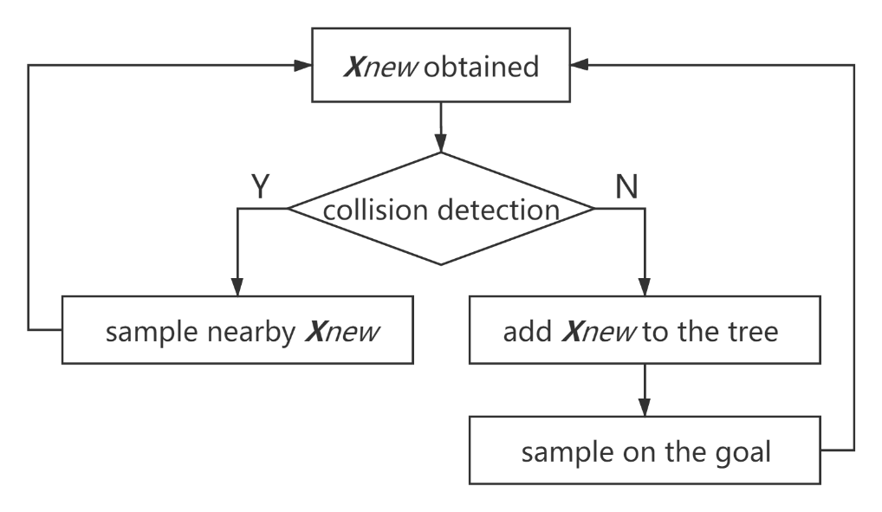
Idea of Variable Sampling Region
VSR-RRT
Sample in a small area centered on the new node after every invalid sampling
Probability up, thus calculation time down
Combined with a high goal bias, to reduce the length of the path
valid
sampling region
invalid sampling?
Probability is increased significantly
new node
sampling region
VSR
Quickly bypass obstacles encountered
high goal bias
( goal bias = 1 )
Extend directly towards the goal
The location of narrow passages
relative to the whole map
doesn't affect the probability
Fig.11 Flowchart of VSR-RRT
Fig.10 VSR-RRT sampling process
Notes:
Combine this approach with … as this flowchart shows.
only when an unavailable node is obtained, it will… otherwise...
extend directly toward the goal and bypass obstacles encountered

Slide 19
Idea of Greedy Path Optimization
A = First node
B = Last node
B =
Previous node
of B
Check visibility:
No
Check visibility
Yes
Visible
A
B
Connect A and B
A = B
B = Last node
node
node
Not visible
No
B = Last node
Obstacle
Yes
A
B
Path optimization Finish
node
node
Fig.12 Flowchart of greedy path optimization
Notes:
removing the redundant nodes on a path, the basic principle is to Check visibility of two nodes.
If a line connecting two nodes does not pass through any obstacle…

Slide 20
Idea of Greedy Path Optimization
A = First node
B = Last node
S
B =
Previous node
of B
Obstacle
1
No
Check visibility
Yes
2
Connect A and B
A = B
B = Last node
No
3
B = Last node
Yes
G
Path optimization Finish
Original path: S→1→2→3→G
Optimized path: S→1→3→G
Fig.12 Flowchart of greedy path optimization
Fig.13 Example of greedy path optimization

Slide 21
Contents
Introduction
1.1 Background
1.2 Previous Research
1.3 Issues and Ideas
Proposed VSR-RRT
2.1 Obstacle Detection
2.2 VSR-RRT
2.2.1 Idea of Variable Sampling Region
2.2.2 Idea of Greedy Path Optimization
Simulation
Conclusion

Slide 22
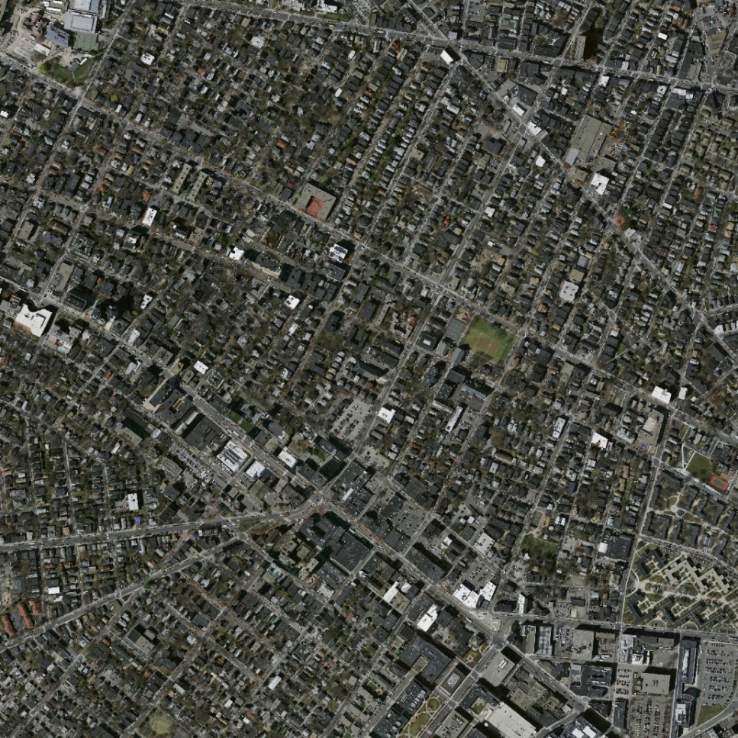
Simulation
Scenario for path planning
Goal
Goal
Start
Start
Fig.14 Aerial image for navigation
Fig.15 Map for path planning

Slide 23
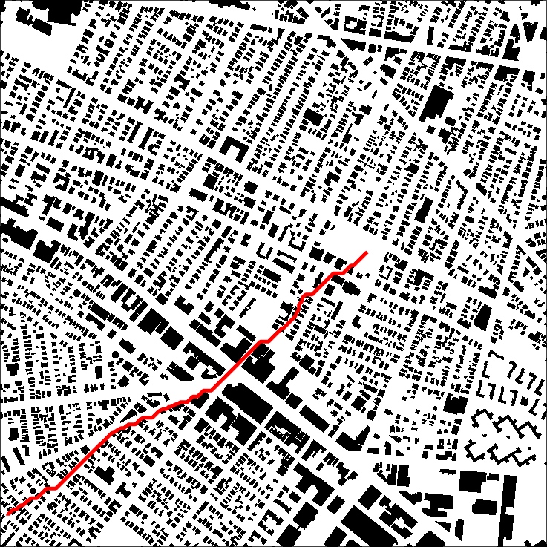
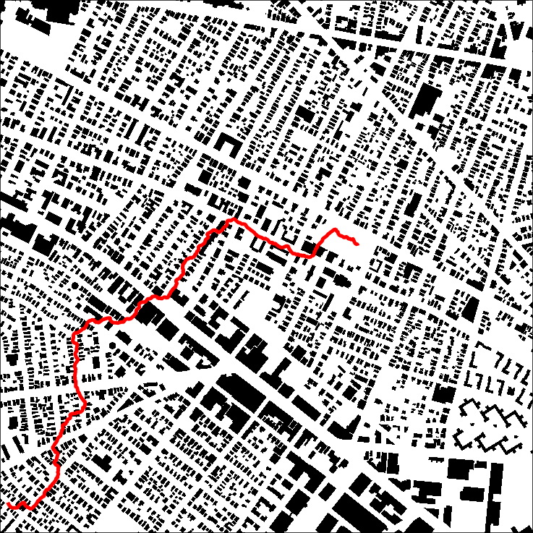
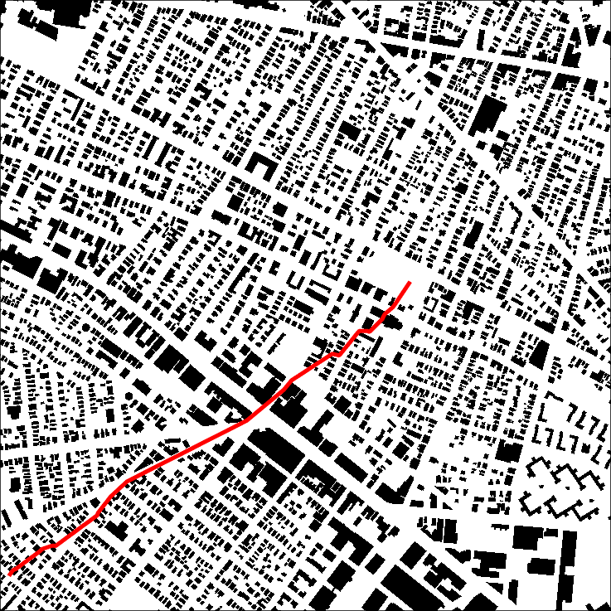
Simulation
Different algorithms is performed in the same scenario
A*
RRT
VSR-RRT
Fig.16 Path planned by different algorithms
algorithm | A* | RRT | VSR-RRT
computation time [sec.] | 248.90 | 0.95 | 0.17
path length [m] | 1282 | 1854 | 1237
the smaller the better
the smaller the better
Tab.1 Processing time and path length of different algorithms

Slide 24
Simulation Results (1/2)
Comparison in computation time [sec.] (Each algorithm was performed 10 times)
2nd
…
1st
3rd
10th
A* takes too much computation time
RRT related algorithms take very little time
computation time [sec.]
computation time [sec.]
best performance
Fig.17 Results and Min, Max and Avg. of ten times

Slide 25
Simulation Results (2/2)
Comparison in path length [m] (Each algorithm was performed 10 times)
path length [m]
2nd
…
1st
3rd
10th
path length [m]
best performance
※shortest path in grid map
best performance
Fig.18 Results and Min, Max and Avg. of ten times

Slide 26
Results Analysis
Performance of VSR-RRT
Computation time decrease by more than 99.9% compared with A* and at least 57% compared with original RRT.
Path length is very close to the theoretical shortest path found by A*. (a little more or less, never increase more than 3%)
It always finds a path with a length close to the theoretical shortest one in less than 0.5 second.

Slide 27
Contents
Introduction
1.1 Background
1.2 Previous Research
1.3 Issues and Ideas
Proposed VSR-RRT
2.1 Obstacle Detection
2.2 VSR-RRT
2.2.1 Idea of Variable Sampling Region
2.2.2 Idea of Greedy Path Optimization
Simulation
Conclusion

Slide 28
Conclusion
VSR-RRT alleviate the over-calculation problem of original RRT and guarantee that it can find the approximate shortest path in a very short time. It can propose fast and convenient navigation for emergency evacuation.
Notes:
alleviate /əˈliːvieɪt/

Slide 29

THANK YOU
THE END

Slide 30
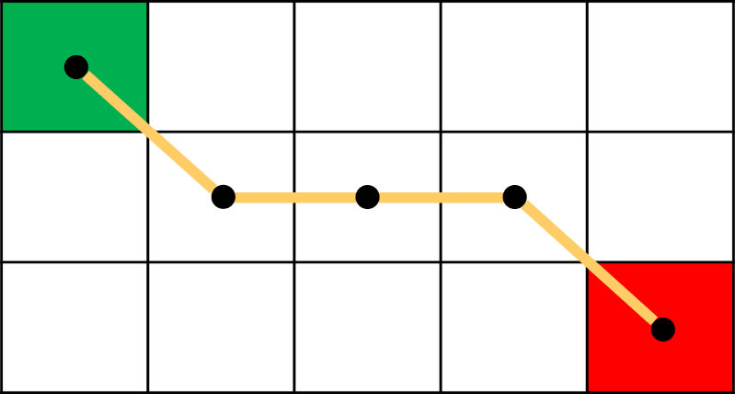
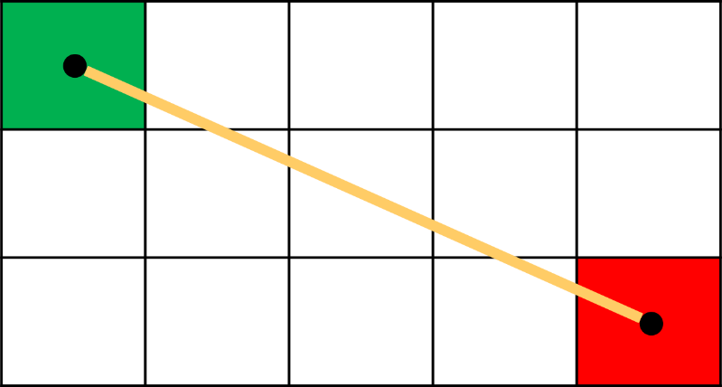
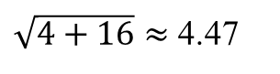
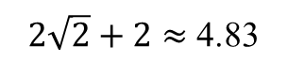
Questions & Answers
Why path planned by A* is not the shortest in simulation ?
1
A*
RRT
Path length:
$2\sqrt{2}+2≈$ 4.83
$\sqrt{4+16}≈$ 4.47
A * algorithm calculates the path length in terms of distance between adjacent nodes, thus the results has errors compare with reality.
The higher the resolution of the grid-based map used by A*, the smaller the errors, the longer the computation time required.

Slide 31
Questions & Answers
Why doesn’t A* use grid-based maps with a smaller resolution ?
(For a short computation time)
A smaller resolution map will lose environmental information.
The loss of environmental information leads some feasible paths cannot be found.
a
18×18 grid-based map
6×6 grid-based map

Slide 32
Questions & Answers
In RRT, why doesn’t zoom the map up to make the narrow passage not so narrow ?
This way will increase the nodes need to be sampled increase significantly, thus increase the computation time and the memory it requires, and the increase is exponential rather than linear, which will make it lose all its advantages compared with the grid-based algorithms.
That is why no researcher uses such a way to solve the narrow passage problem in RRT, it is like a kind of cheating but not a considerable solution.

Slide 33
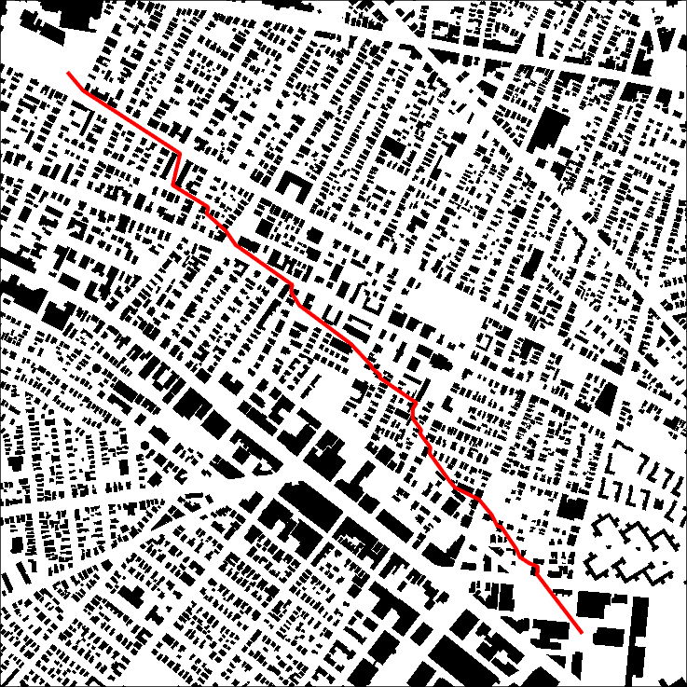
Simulation & Result
Scenario 2
Goal
Start
Aerial image for navigation
Map for path planning

Slide 34
Simulation & Result
Comparison in computation time [sec.] and path length [m] (Each algorithm was run 10 times)
computation time [sec.]
path length [m]

Slide 35
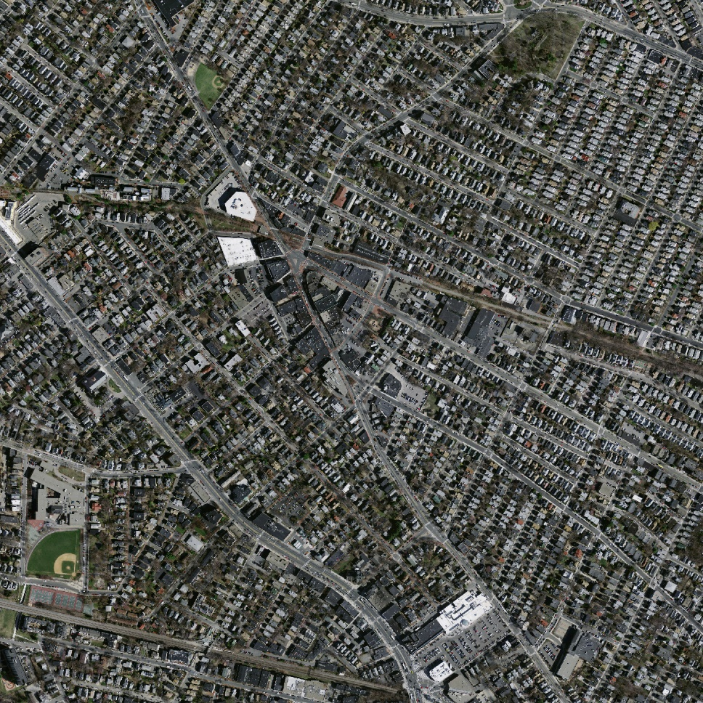
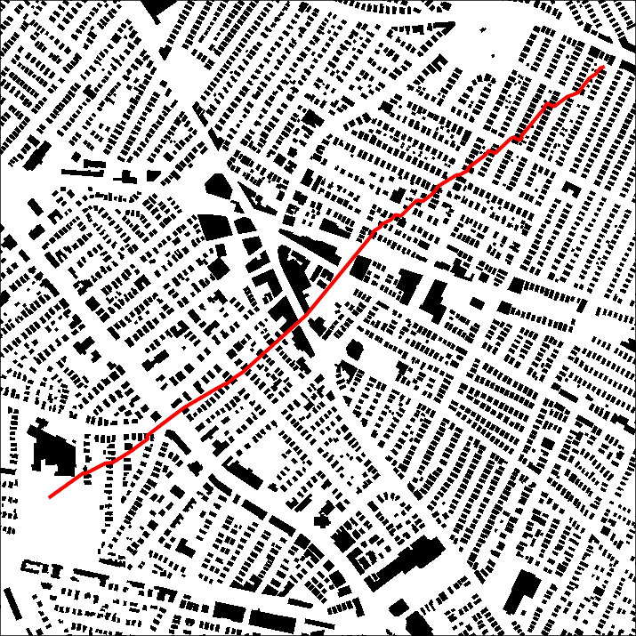
Simulation & Result
Scenario 3
Start
Goal
Aerial image for navigation
Map for path planning

Slide 36
Simulation & Result
Comparison in computation time [sec.] and path length [m] (Each algorithm was run 10 times)
computation time [sec.]
path length [m]

Slide 37

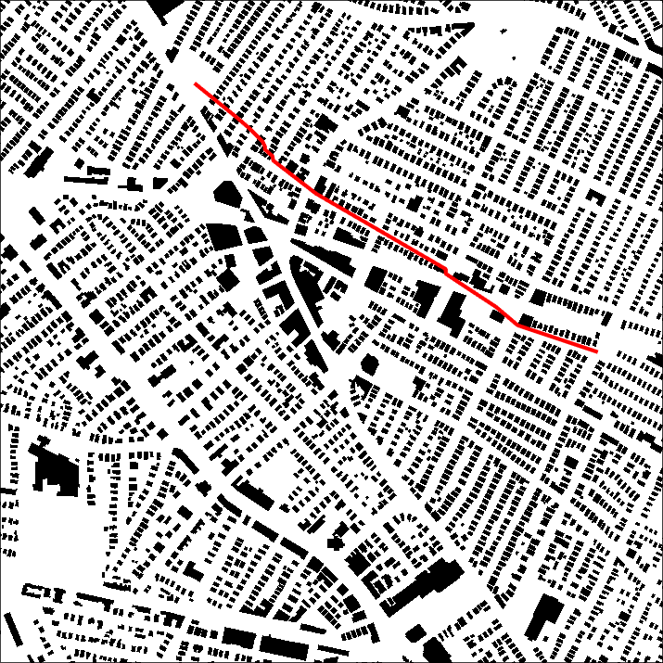
Simulation & Result
Scenario 4
Goal
Start
Aerial image for navigation
Map for path planning

Slide 38
Simulation & Result
Comparison in computation time [sec.] and path length [m] (Each algorithm was run 10 times)
computation time [sec.]
path length [m]

Slide 39
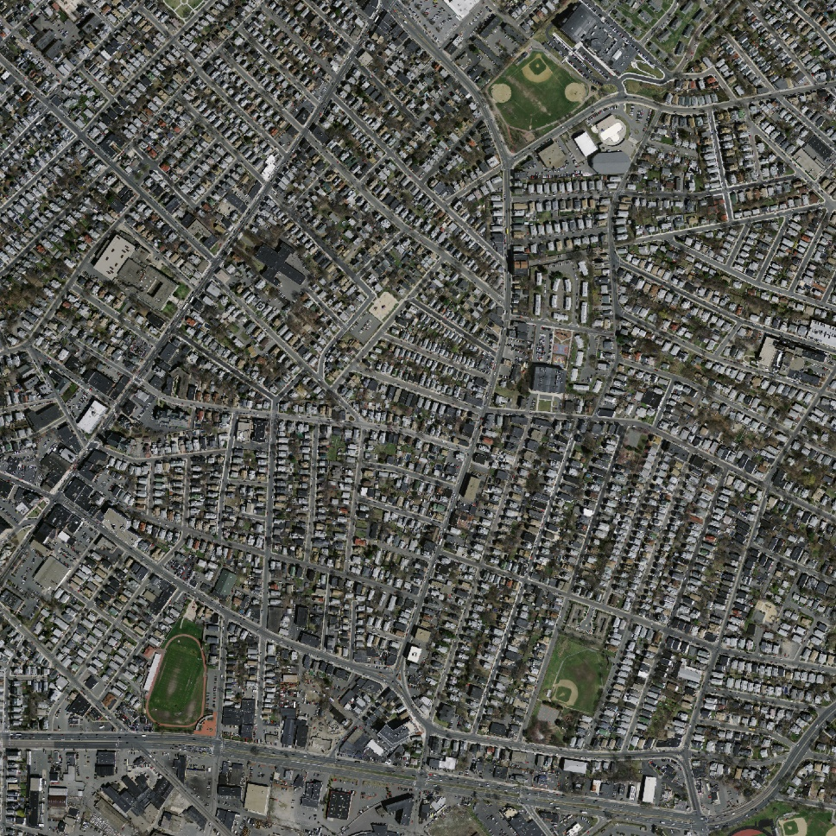
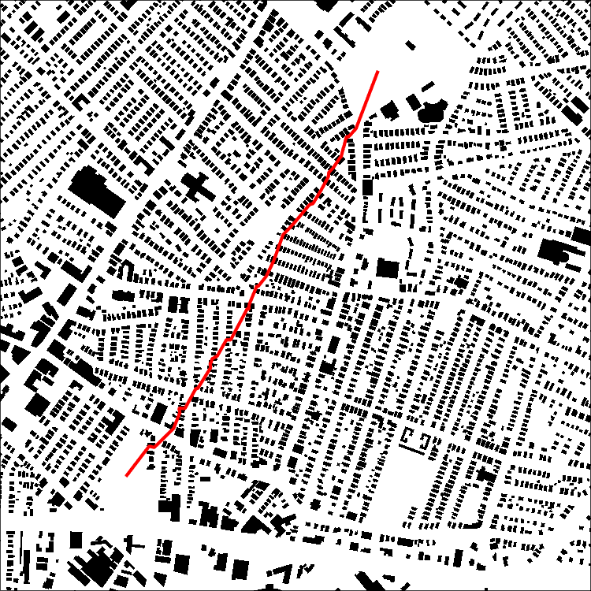
Simulation & Result
Scenario 5
Goal
Start
Fig.13 Aerial image for navigation
Fig.14 Map for path planning

Slide 40
Simulation & Result
Comparison in computation time [sec.] and path length [m] (Each algorithm was run 10 times)
computation time [sec.]
path length [m]

Slide 41
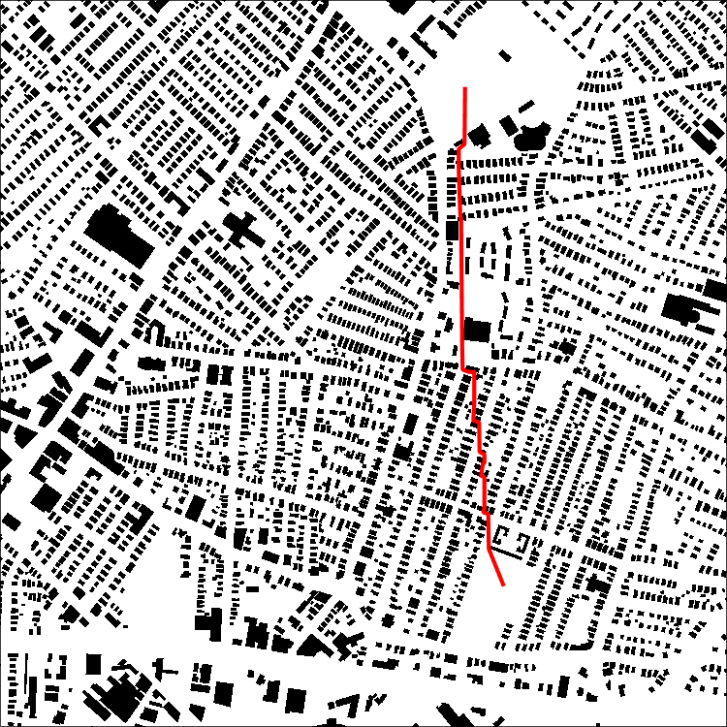
Simulation & Result
Scenario 6
Goal
Start
Fig.13 Aerial image for navigation
Fig.14 Map for path planning

Slide 42
Simulation & Result
Comparison in computation time [sec.] and path length [m] (Each algorithm was run 10 times)
computation time [sec.]
path length [m]

